Slide 1
Scraping with BeautifulSoup
MGMT 590: Web Data Analytics
Lecture 5
Notes:
Source: De Liu, University of Minnesota

Slide 2
BeautifulSoup
An HTML/XML parser for Python that can turn even invalid markup into a parse tree. It provides simple, idiomatic ways of navigating, searching, and modifying the parse tree.
Navigate the soup of HTML tags
Access tag’s properties and values
Search for tags and their attributes
HTTP response
(HTML raw text)
BeautifulSoup object
Navigate/Search
(BeautifulSoup objects)
Extract

Slide 3
Example
Need to install package beautifulsoup4
from bs4 import BeautifulSoup
import urllib2
source = urllib2.urlopen(“www.example.com")
html = source.read()
soup = BeautifulSoup(html)
for u in soup.find_all(‘h3',class_=‘schoolname'):
print university.string
Get http server response
Convert to bs4 object
Search by tag type and class attribute
Extract tag attribute and text
“class” is a reserved word in Python. So, we use class_!

Slide 4
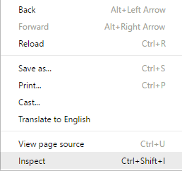
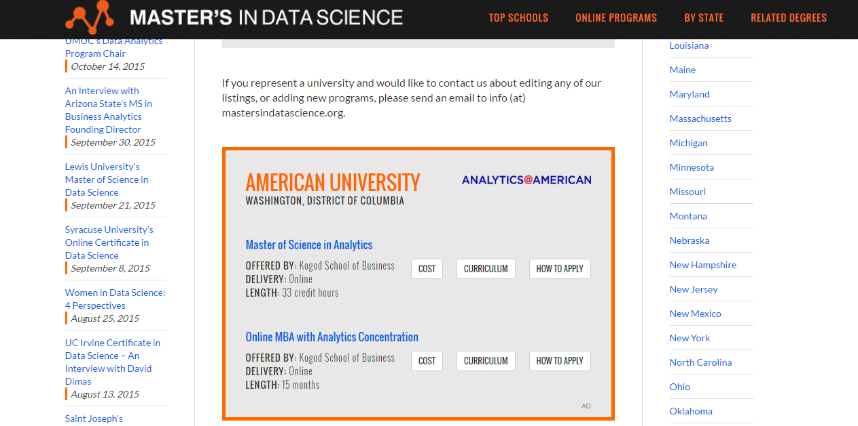
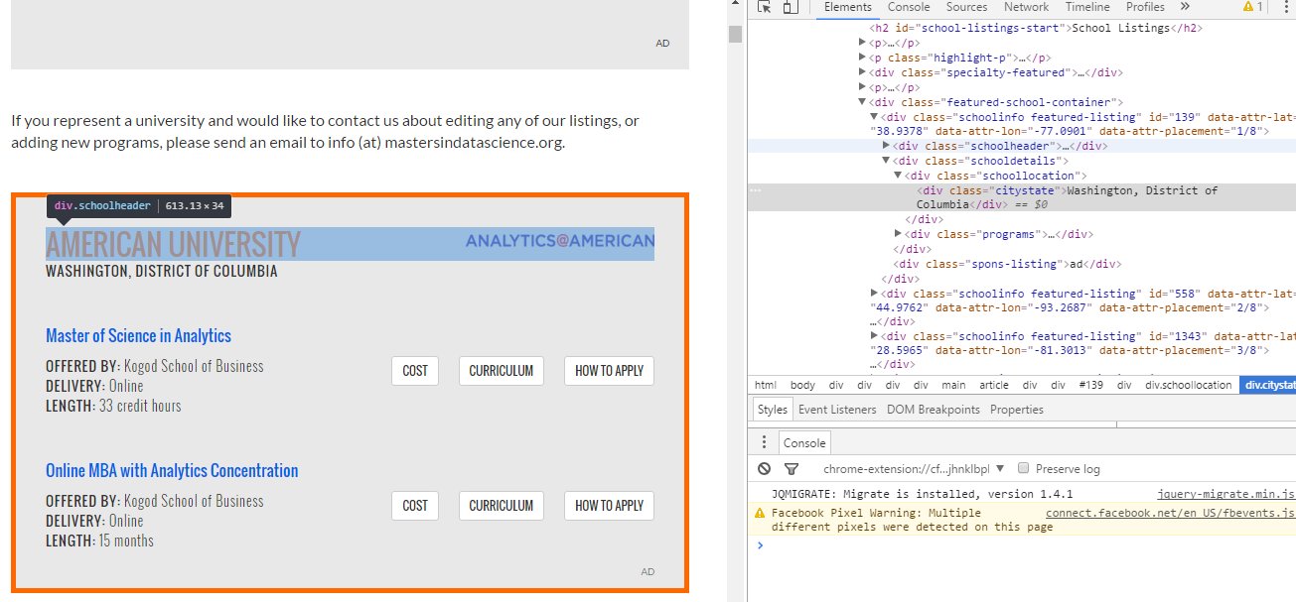
Inspect HTML Source Using Chrome Developer Tools

Slide 5
BeautifulSoup
Suggestion: you go over official documentation (skip the HTML modification topics)
Print bs4 object in formatted HTML:
print soup.prettify()
Navigate HTML tag hierarchy
soup.title, soup.p.a
Extract textual content in the tag
soup.string, soup.strings #if there are multiple pieces, or
soup.get_text()
Extract tag attributs
tag['class'], tag['href'],
tag.attrs #return a list of attribute names
tag.has_attr('class') #whether it has an attribute

Slide 6
Location Information with find/find_all
find, find_all are used for find one or all tags meeting a criteria
Find by tag type
soup.find_all('a')
Find by id (or other attributes)
soup.find(id="link3")
Find by class name
soup.find_all(class_=“title")
Find by combination of factors
soup.find_all("a", class_="sister")
Find by text
soup.find_all(text="Elsie")
Many of them support regular expressions
soup.find_all(re.compile("^b")) #any tag starts with letter b, e.g. <b> and <body>

Slide 7
CSS-style selector using select
Find tags beneath other tags
soup.select("body a")
soup.select("head > title") #directly beneath another tag
Find tags that is n-th of the same type
soup.select("p > a:nth-of-type(2)") #2nd <a> tag under p
CSS-style tag qualifiers
soup.select('a[href]') #tag with attribute href
soup.select('a[href="http://example.com/elsie"]')
soup.select('a.title') #tag of class title

Slide 8
Look around
Find among parents
soup.find(text="Lacie").find_parent("p") #find the p tag containing the text Lacie
Next and previous sibling
soup.find(text="Lacie").find_next_siblings("a") # find the next sibling of the tag containing Lacie.
List direct children of the current tag
for child in title_tag.children:
print(child)

Slide 9
Practice Time !!!

